Slide 1
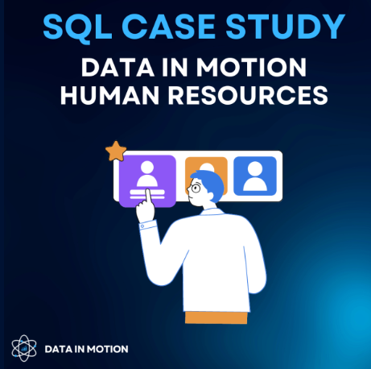
SQL Case Study 2
Human Resources

Slide 2
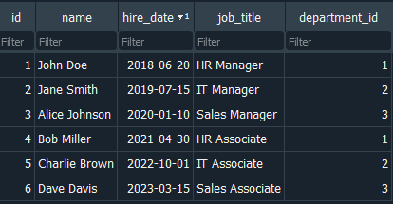
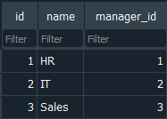
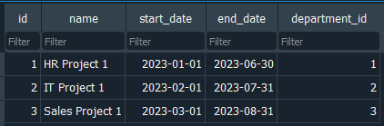
Datasets
Projects
Employees
Departments

Slide 3
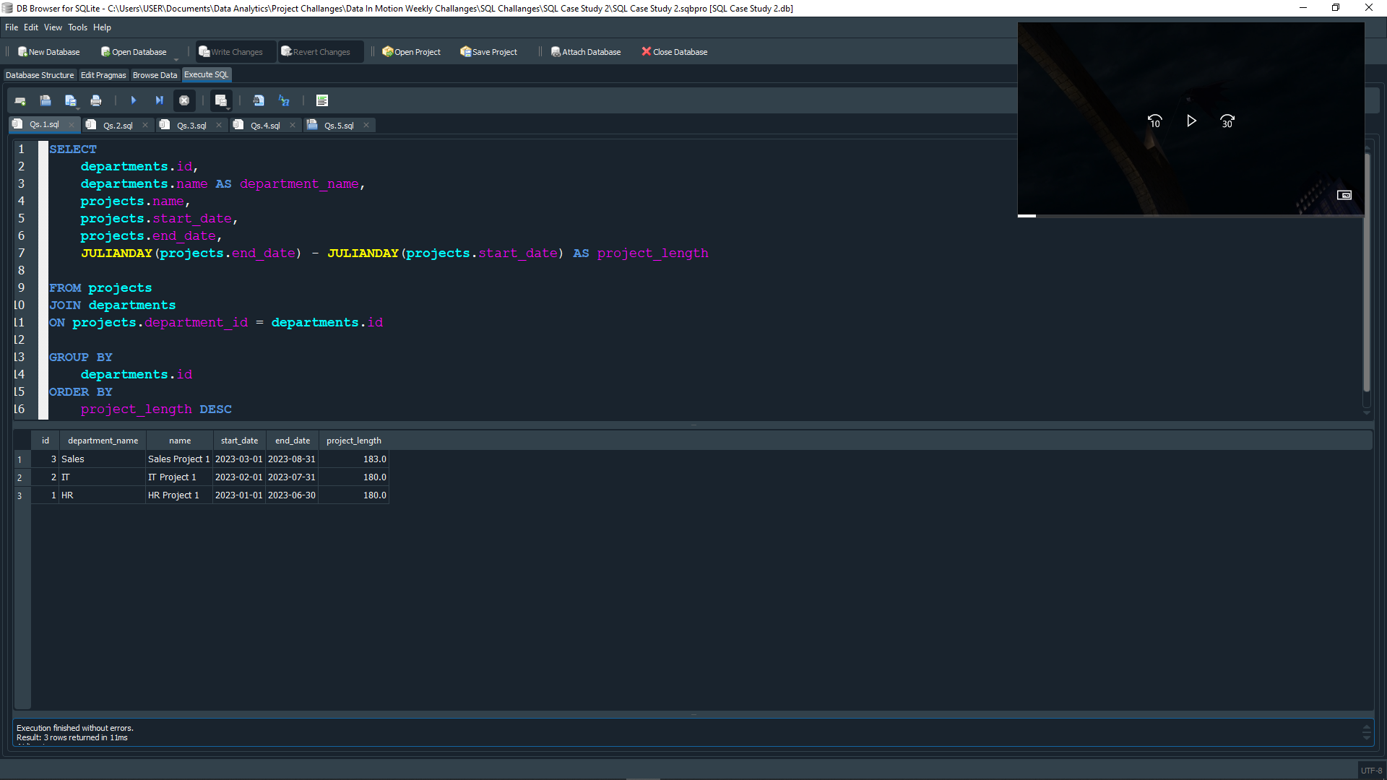
Question 1
Find the longest ongoing project for each department.

Slide 4
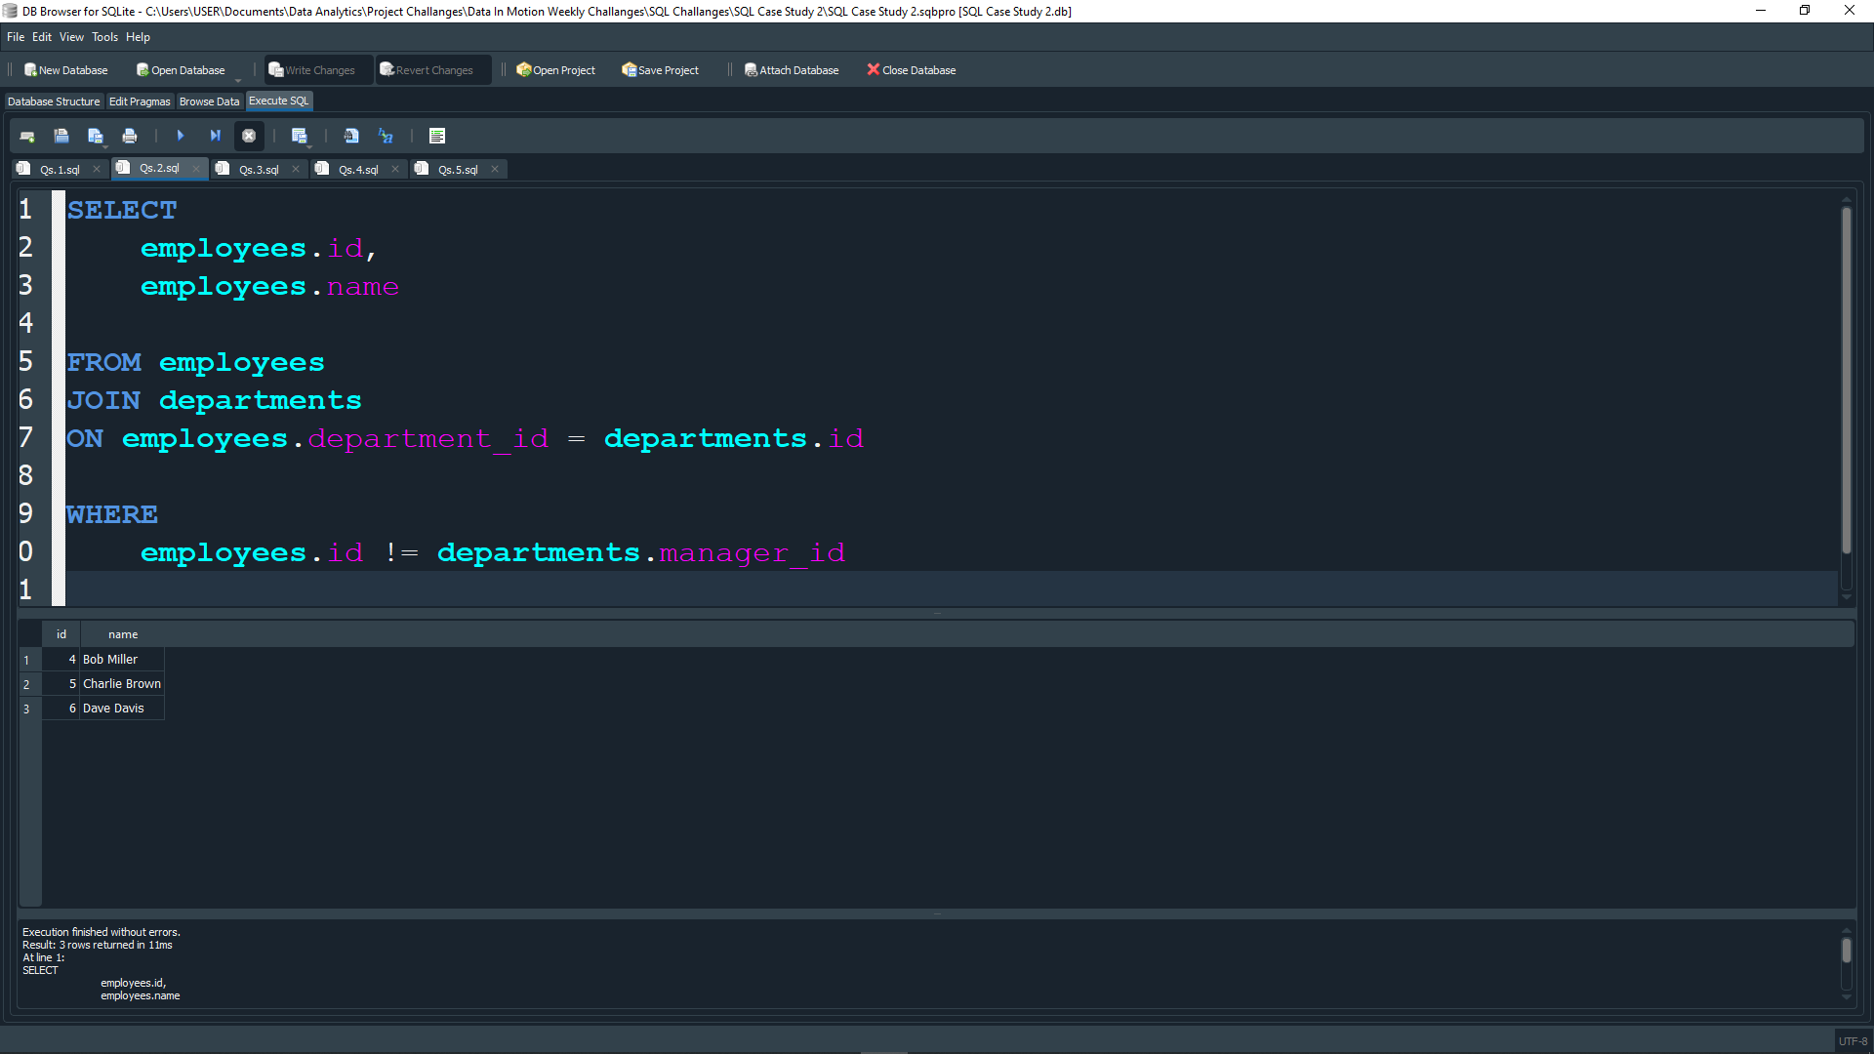
Question 2
Find all employees who are not managers.

Slide 5
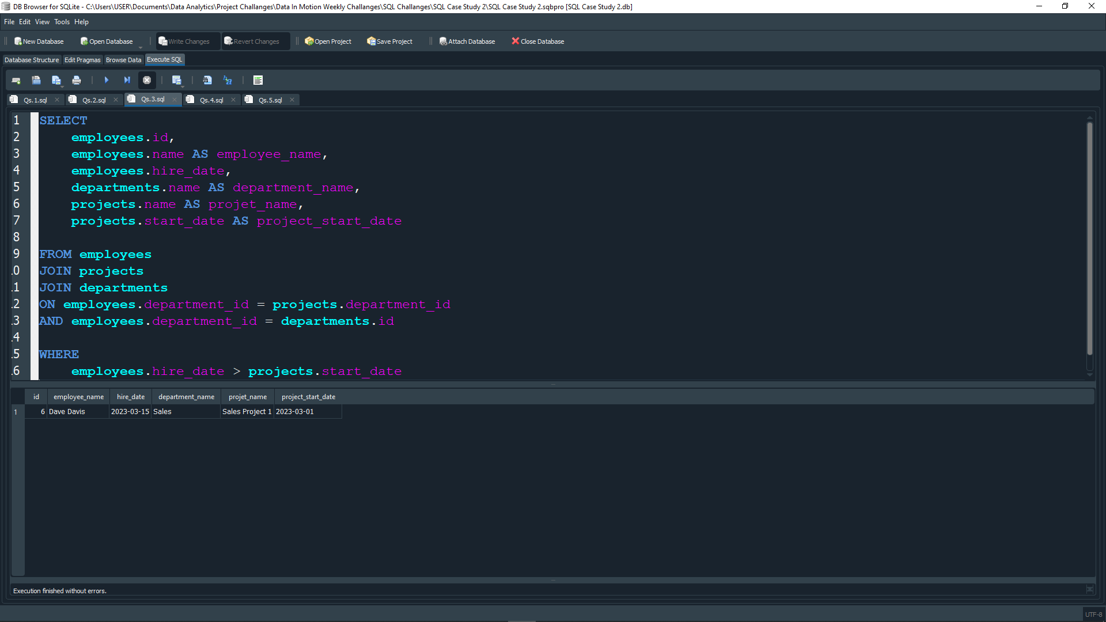
QUESTION 3
Find all employees who have been hired after the start of a project in their department.

Slide 6
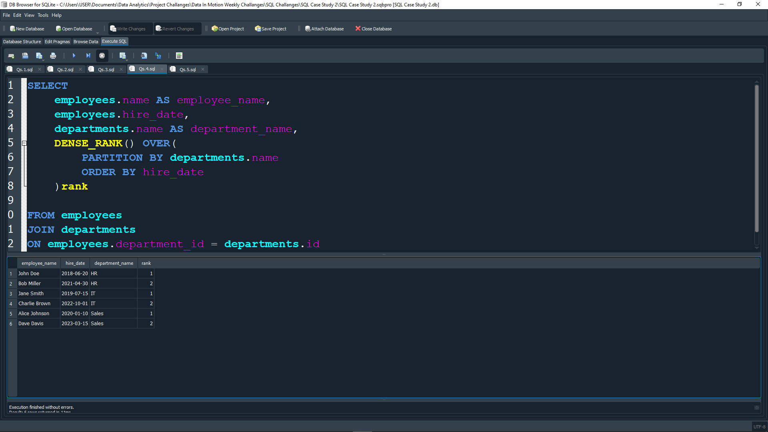
QUESTION 4
Rank employees within each department based on their hire date (earliest hire gets the highest rank).

Slide 7
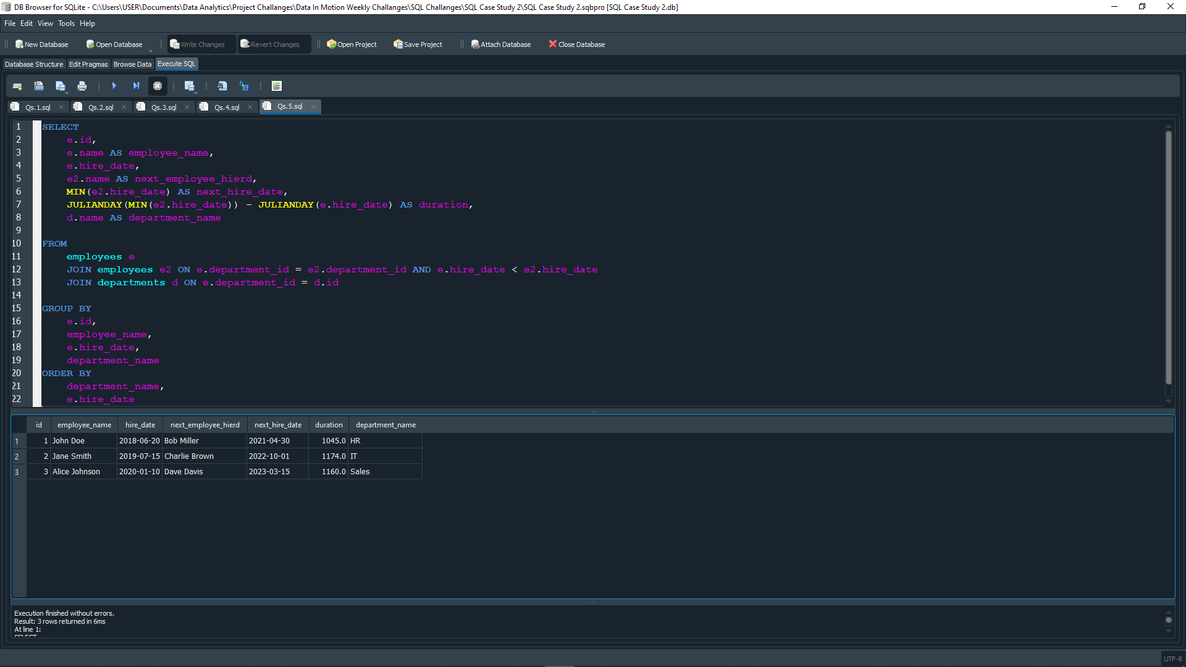
QUESTION 5
Find the duration between the hire date of each employee and the hire date of the next employee hired in the same department.

Slide 8
THANK YOU
Name: Jermaine Herman Sangiwa
Email: jermaine@sangiwa.com
LinkedIn: https://www.linkedin.com/in/jermainesangiwa

